Slide 1
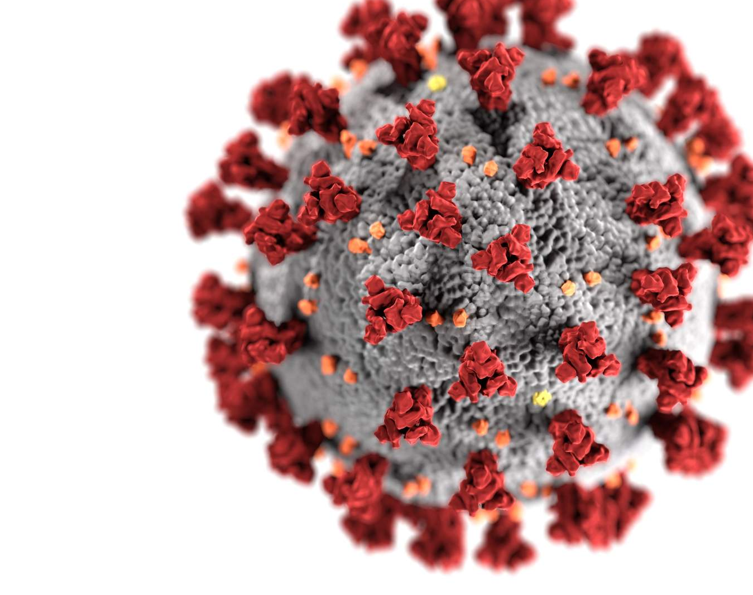
Covid 19 Test Cases and Deaths
Hasala Kalubowila – 2021s18856
Ridma Jayawardena – 2021s18852
Pasindu Chamara – 2021s18849
Dinidu Dasun – 2021s18867

Slide 2

About Dataset
Source: Likely from a public health department
Weekly COVID-19 data tracked by ZIP code
Contains information on:
Cases (weekly + total)
Tests (weekly + total)
Deaths (weekly + total)
Includes calculated rates per 100,000 population

Slide 3
Machine Learning Models Used
Random Forest Machine Learning Model
Decision Tree Machine Learning Model
Gradient Boost Machine Learning Model
Deep Neural Network Machine Learning Model

Slide 4

Random Forest Destribution

Slide 5
Let’s discuss
Data preprocessing
Hyperparameter optimization
Strategies for improving model performance

Slide 6
Why Random Forest?
Ensemble Learning Utilizes an ensemble of decision trees to generate more accurate and reliable predictions.
Improved Generalization Significantly lowers the risk of overfitting when compared to single decision trees.
Versatile Feature Handling Capably manages datasets with a mix of categorical and numerical variables.
High Classification Accuracy Demonstrates consistently strong results in classification applications.

Slide 7
Data Preprocessing
Addressing missing data
Encoding categorical variables
Data splitting
Data transformation
Performing aggregations while excluding null values
Eliminating redundant or irrelevant columns
Conducting feature engineering to enhance model performance
Identifying and removing duplicate records

Slide 8
Baseline Model Performance
Mean Squared Error (MSE) : 543.35
Mean Absolute Error (MAE) : 2.95
R-squared (R² Score): 94.87%
Interpretation: Good fit on training, underfitting, or data noise affecting test predictions.

Slide 9
Systematic Hyperparameter Tuning
Used RandomizedSearchCV with cross-validation
Tuned parameters:
n_estimators: 100 → 500
max_depth: 10 → 50
min_samples_split, min_samples_leaf, bootstrap
Evaluation via 5-fold CV to avoid overfitting

Slide 10
Improved Model After Tuning
Mean Squared Error (MSE) : 495.86
Mean Absolute Error (MAE) : 3.95
R-squared (R² Score): 96.93%
Feature Importance (Top 3):
Week Start
Total Tests
Percent Positivity

Slide 11
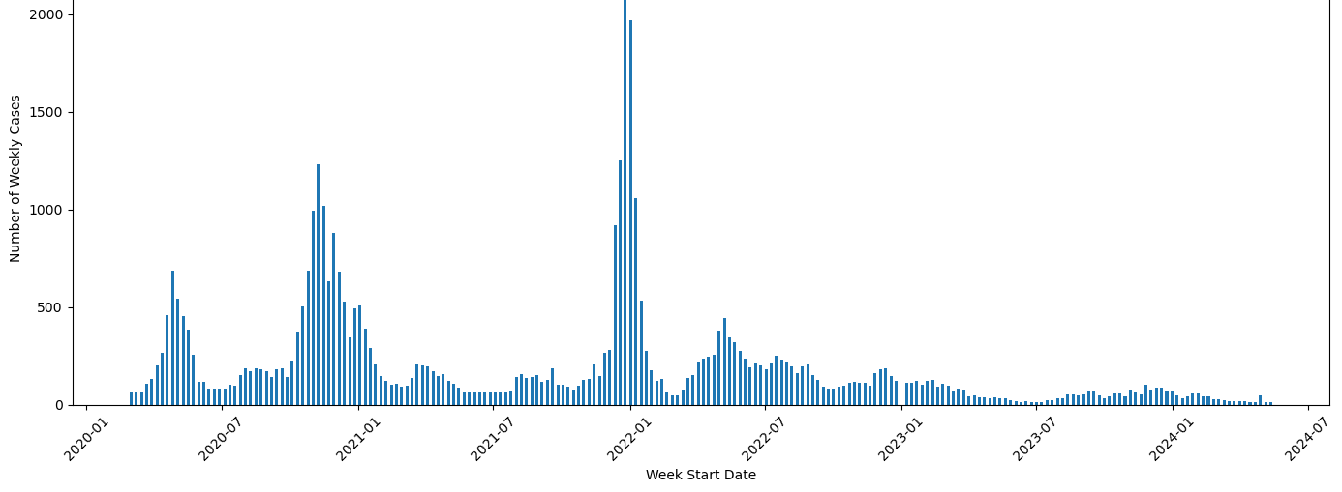
Time Series Visualization

Slide 12
Conclusion
Random Forest offers high interpretability and stable performance.
Preprocessing and tuning significantly enhanced model accuracy.
Future scope: Incorporate demographic and mobility data to further improve predictions.

Slide 13

Decision Tree Model Exploring the Effectiveness of Decision Trees in Predicting COVID-19 Weekly Cases W.H.Pasindu Chamara(2021s18849)

Slide 14
Data Preprocessing
Handling Missing values
Replace 'Unknown' Values with NaN
Imputing Missing Values
Removing Unnecessary Columns
Converting Data Types
Feature Engineering
Checking for Duplicates

Slide 15

Introduction to Decision Tree Model
A Decision Tree is a supervised learning algorithm used for both classification and regression tasks.

Slide 16

Why Choose Decision Tree Regressor?
Handles Non-Linear Relationships
Interpretability and Transparency
Minimal Data Preprocessing
Flexibility and Versatility
Effective for Handling Large Datasets with Many Feature
Performance with High Variance Data
Easy Hyperparameter Tuning

Slide 17
Model Performance
Mean Absolute Error (MAE): 4.1203
Mean Squared Error (MSE): 711.8736
R-squared (R² Score): 95.8450%

Slide 18
Hyperparameter Tuning
MethodGridSearchCV (cv=5)
Parameters
max_depth
min_samples_split
min_samples_leaf
max_features

Slide 19

Optimized Model Performance
Best Parameters:
max_depth: 20
max_features: None
min_samples_leaf: 1
min_samples_split: 2
Optimized MSE: 674.2795
Optimized MAE: 4.1368
R-squared (R² Score): 96.06%

Slide 20
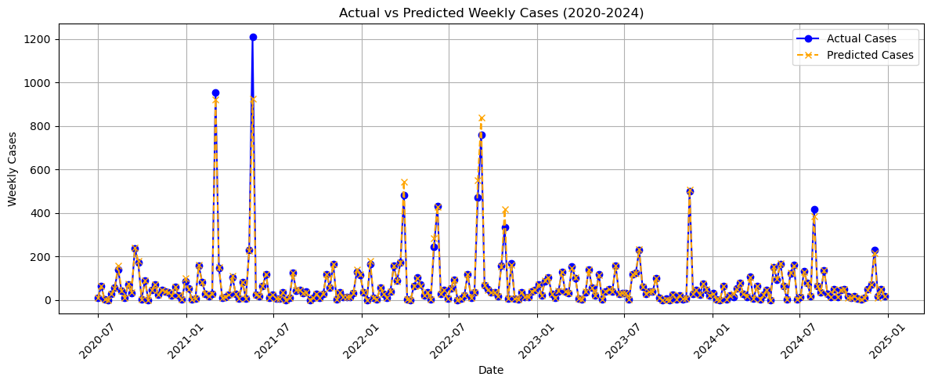
Time Series Visualization

Slide 21
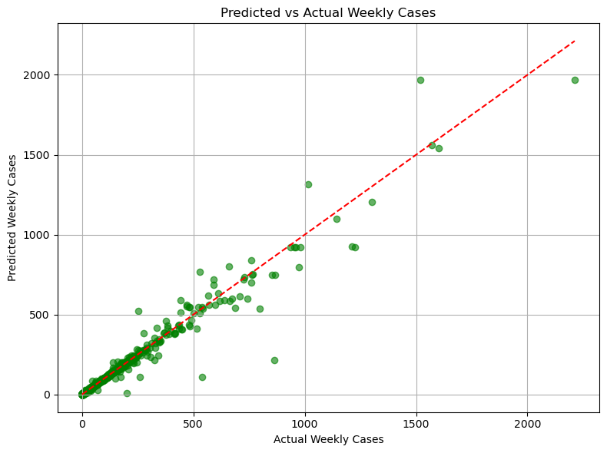
Prediction Accuracy Visualization

Slide 22
Conclusions
Decision tree achieved 96.06% R² score after optimization
Model effectively captures relationships in COVID-19 data
Prediction accuracy suitable for public health planning

Slide 23

Gradient Boosting Model
S16102 – Dinidu Kiriella

Slide 24
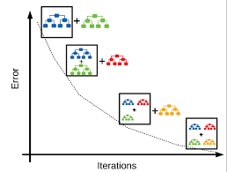
Why Gradient Boosting model
Captures Complex Nonlinear Patterns:
COVID-19 spread patterns across ZIP codes may involve nonlinear relationships between testing, cases, deaths, and population, which gradient boosting captures effectively.
Performs Well with Mixed Data Types:
This dataset combines categorical (ZIP Code) and numerical data (case rates, death rates), which gradient-boosting models can process efficiently.
Well handles medium-sized datasets:
With over 13,000 rows, it handles medium-sized datasets like this efficiently without overfitting.
Proven in Epidemiological Data:
Gradient boosting has been widely used and validated in public health analytics, making it a trusted choice.

Slide 25
Data Preprocessing
Missing Values
Numerical columns | Categorical Column
Cases - Weekly Cases - Cumulative Case Rate – Weekly Case Rate – Cumulative Tests - Weekly | ZIP Code Location
Initial Inspection:
Loaded the dataset and used info() and isnull().sum() to understand the data structure, types and missing values. And also checked for duplicate values
Handling Missing Data:
Filled in missing numerical values with column means. For the categorical column used the most frequent value (mode).
Date Conversion:
Converted Week-Start and Week-End columns to proper datetime format for easier time-based analysis.
Validation After Cleaning:
Rechecked for any remaining missing values to ensure the dataset was clean and ready for modeling.

Slide 26

Model Training
In this model training, the target variable was the “Cases - Weekly”.
This modified, preprocessed dataset has 13 columns. therefore, to train a more accurate model, we used the correlation and chose the more impactful column for the model training according to the correlation value.
With train_test_split() from scikit-learn dataset divided into training set and a testing set for 0.8 and 0.2.
Then the model train with the default value of the GradientBoostingRegressor() such as,
learning_rate=0.1
max_depth=3
min_samples_leaf=1
n_estimators=100

Slide 27
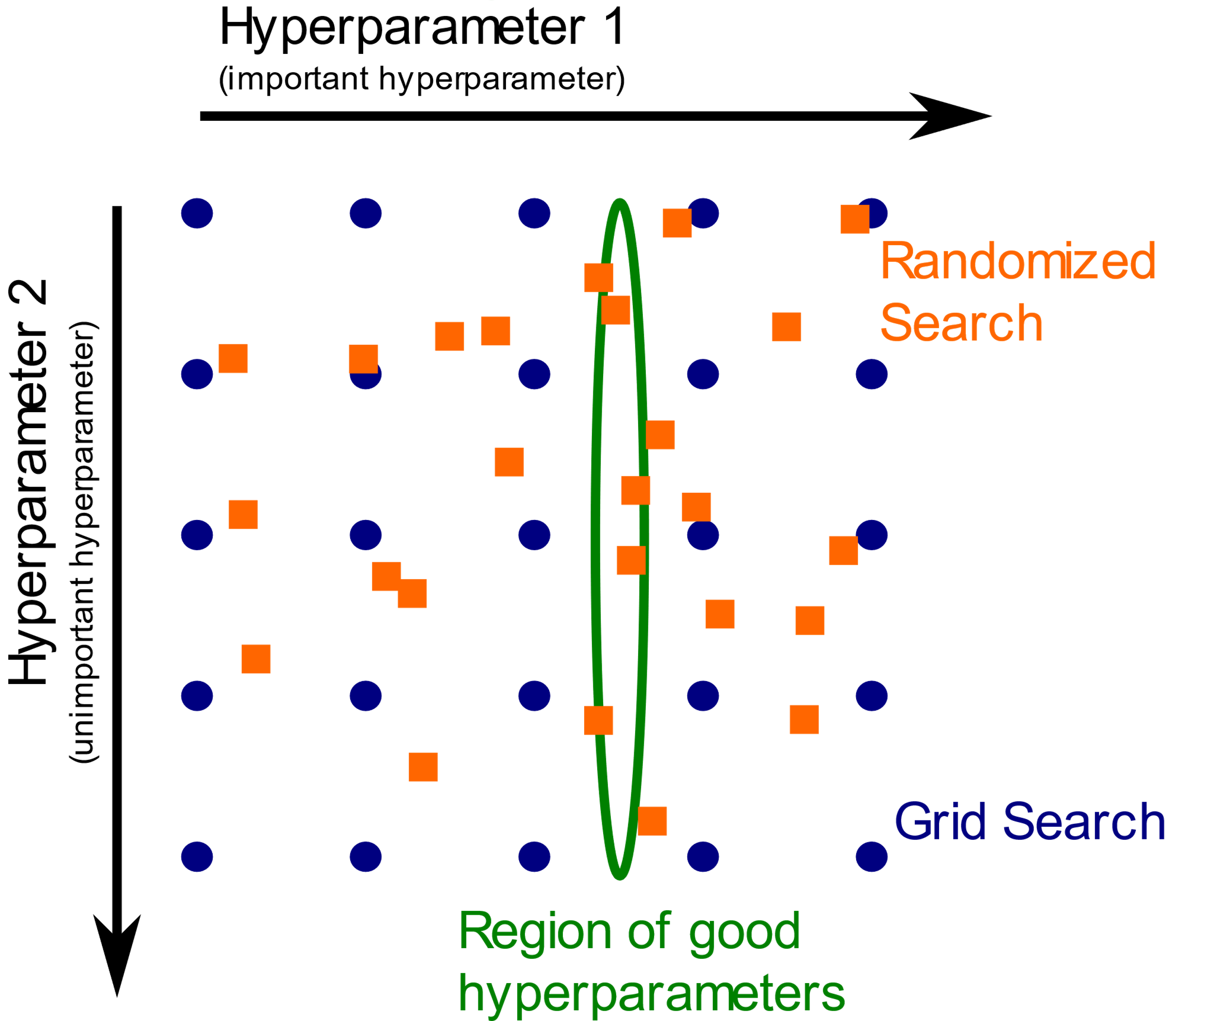
Hyperparameter tuning
Our goal is to enhance the performance of the Gradient Boosting model by systematically searching for the best hyperparameter combinations.
Used RandomizedSearchCV with cross-validation to efficiently explore a broad range of hyperparameter settings without exhaustively checking all combinations.
Explored variations in model complexity, learning speed, and generalization ability (subsample rate, feature sampling)
Tuned model achieved better balance between bias and variance, improving predictive higher R², lower MAE and MSE

Slide 28

Result and Conclusion
 | Initial Model | After Tuning
Mean Squared Error (MSE) | 541.12 | 476.46
R^2 Score | 96.84 | 97.22
The initial model performed well, capturing most of the variance in the dataset, but it still left room for improvement.
The tuned model showed noticeable improvements in all metrics, especially in reducing prediction errors

Slide 29
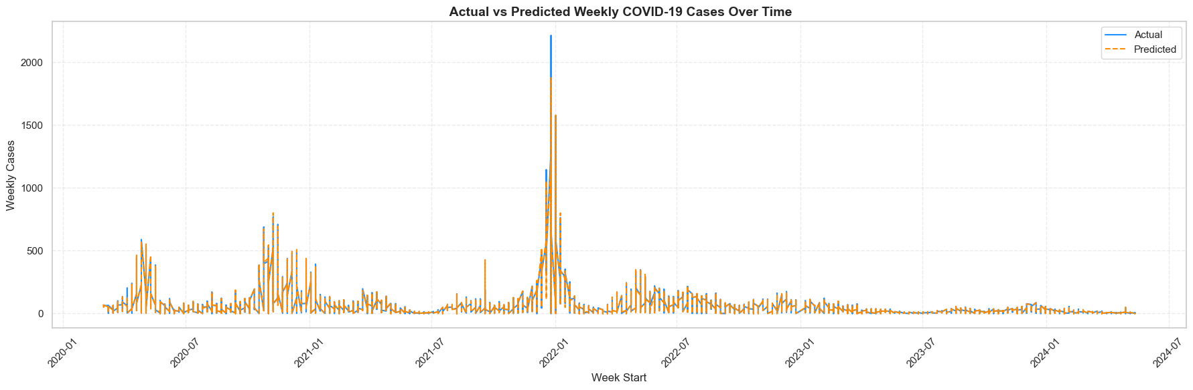
So, as a conclusion, Hyperparameter tuning significantly boosted model precision, making it more reliable for predicting and analyzing public health patterns at the local level.

Slide 30


Deep Neural Network Model

Slide 31

Why Use a Deep Neural Network (DNN)
Captures Complex Patterns :-
DNNs can model non-linear relationships between features (e.g., test rate, lagged cases) and target (weekly cases)
Works Well with Time-Dependent Features
When engineered with lags, DNNs handle time-based trends even in non-sequential models.
Robustness via Dropout & Layers
Multiple hidden layers with dropout reduce overfitting and help generalize well to unseen data.
Scales Well to More Features
Easily expandable to include new variables like mobility, climate, or policy effects.
.

Slide 32
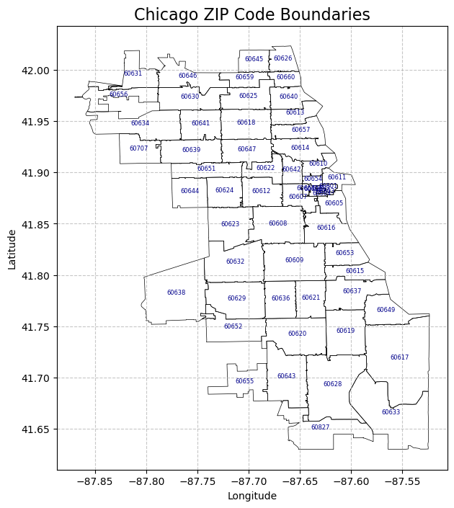
Handling Missing values
Aggregations skip NaN values
Custom rules for positivity rate when no tests conducted
Removing Unnecessary Columns
combine all zip code regions into 7 main regions
Converting Data Types
Feature Engineering
Checking for Duplicates
make a correlation matrix to find the best features
Data preprocessing

Slide 33
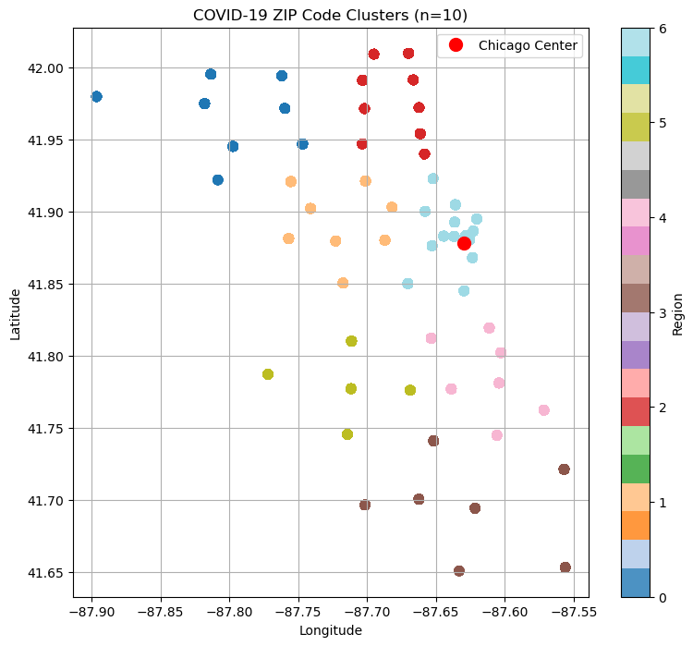
Model creation and training
DNN Architecture:
Input Layer: Receives standardized feature vectors
Hidden Layers:
Dense(128, ReLU) + Dropout(0.3)
Dense(256, ReLU) + Dropout(0.3)
Dense(128, ReLU)
Output Layer: 1 neuron → Predicts weekly cases
Training Configuration:
Loss Function: Huber Loss (delta = 1.5)
→ Balances sensitivity & robustness to outliers
Optimizer: Adam (learning rate = 0.001)
Early Stopping: Prevents overfitting (patience = 15 epochs)
Validation Split: 20% time-based test data (no shuffling)

Slide 34
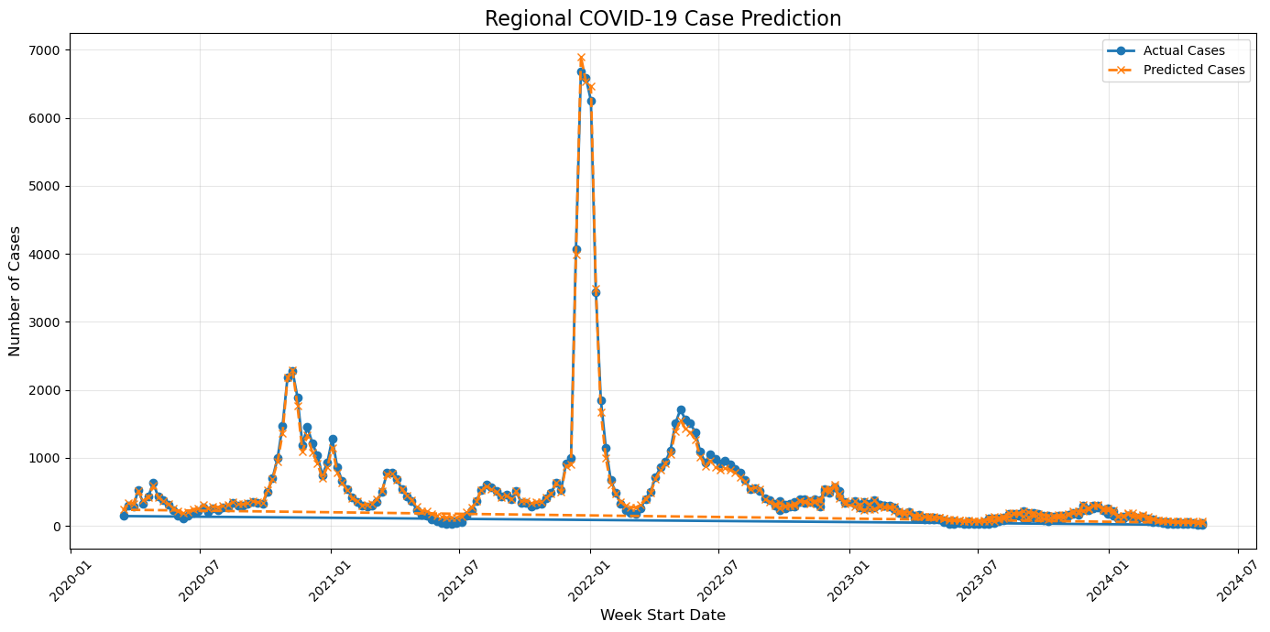
Prediction Results
from the graph we can see that the highest surge of cases happend in the end of 2021 and in early 2022
By mid-October, a third surge of cases began; there were over 200,000 new daily cases during parts of December 2020 and January 2021.[22][23 - wikipedia

Slide 35
Model evaluation
Evaluation Metrics:
Huber Loss:
Balanced metric combining MAE and MSE behavior
Final Test Loss: 0.0017
MAE (Mean Absolute Error):
Scaled MAE: 0.0414
Real-world Error: ~567.5 cases
R² Score - 0.9960
Visualization – Actual vs Predicted Cases:
Clear alignment between predicted and actual weekly case counts
Model successfully captures regional trends over time

Slide 36
Final conclusion
Model | R² Score | MAE | Remarks
DNN (Deep Neural Net) | 0.9960 | 0.0414 (Scaled) | Best performance, captures complex patterns
Decision tree regressor | 0.9606 | 4.14 (scaled) | Good, improved with tuning
Random Forest Regression | 0.9600 | 6.28 (scaled) \ | Robust, slightly lower than DNN
Gradient Boosting Regression | 0.9722 | (MSE = 476.46) | Strong, but still under DNN

Slide 37
Thank You

